Slide 1


Title Slide
Project Name: Road Accident Assistance Mechanism (RAAM)
Team Name: AGNI
Problem Statement ID: EK-07
Problem Statement Overview :
Vehicle owners facing breakdowns often struggle to explain their issue clearly and share accurate location details, causing delays in roadside assistance. Traditional support systems rely on manual calls and inefficient dispatch coordination.
Problems:
1.Difficulty in accurately describing vehicle issues and sharing precise location.
2.Delayed assistance due to manual dispatch and lack of real time mechanic allocation.
Solution Overview:
A Complete Self Autonomous Advanced Road Emergency Management System coordinated, technology-driven framework designed to detect, respond to, and clear traffic incidents, disasters, or accidents to enhance safety and restore traffic flow. These systems utilize real-time data, AI-powered vehicle detection, and intelligent signaling to optimize emergency vehicle routes and minimize response times.
Page 1

Slide 2
Solution Details
Proposed Solution
1. Idea / System Overview
A Voice-First V2I Road Assistance System using Transformer-based NLP for intent and location extraction. Supports Dual-Mode Connectivity:
Online: HTTPS + JSON payloads
Offline: ESP32 WiFi Self-Healing Mesh with multi-hop packet forwarding (VANET)
A Cloud LLM Agent performs semantic parsing and auto-dispatches requests to Garages, Fuel Stations, or NHAI.
2. Problem Addressed
Cognitive Load Reduction: Zero-UI, hands-free Natural Language Interaction for emergency scenarios.
Dead-Zone Resilience: WiFi Mesh Networking ensures reliable data delivery without cellular dependency.
3. Innovation & Uniqueness
Hybrid Edge–Cloud Architecture: WiFi offline hopping + Generative AI inference.
Semantic Dispatch Engine: Context-aware routing over keywordbased systems for accurate emergency handling.
Page 2

Slide 3

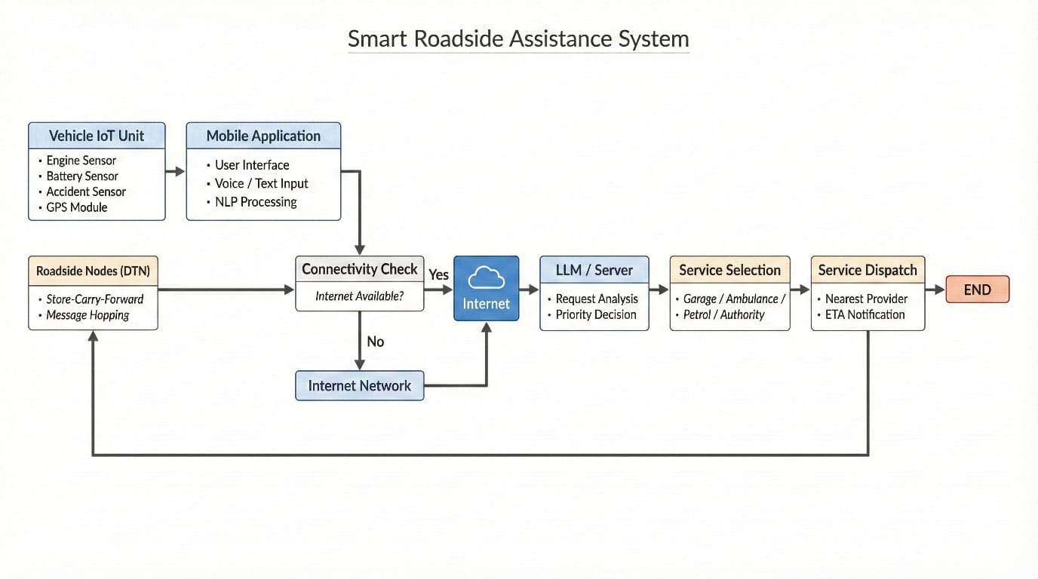
Technical Details
Technologies to be used (e.g. programming languages, frameworks, hardware)
Programming Languages: Python, C#, Arduino.
Frameworks & Tools: ESP-IDF / ESP32 Arduino Framework, QML, Groq LLM Framework, FAST Framework.
IoT Hardware (Vehicle): ESP32/Arduino NANO, GPS module, accelerometer, battery sensor.
Networking: Wi-Fi/ESP, DTN (store–carry–forward), REST APIs, DSRC, IEEE.801.p.
Services: LLM API.
Methodology and process for implementation (Flow Charts/Images/ working prototype)
Page 3

Slide 4
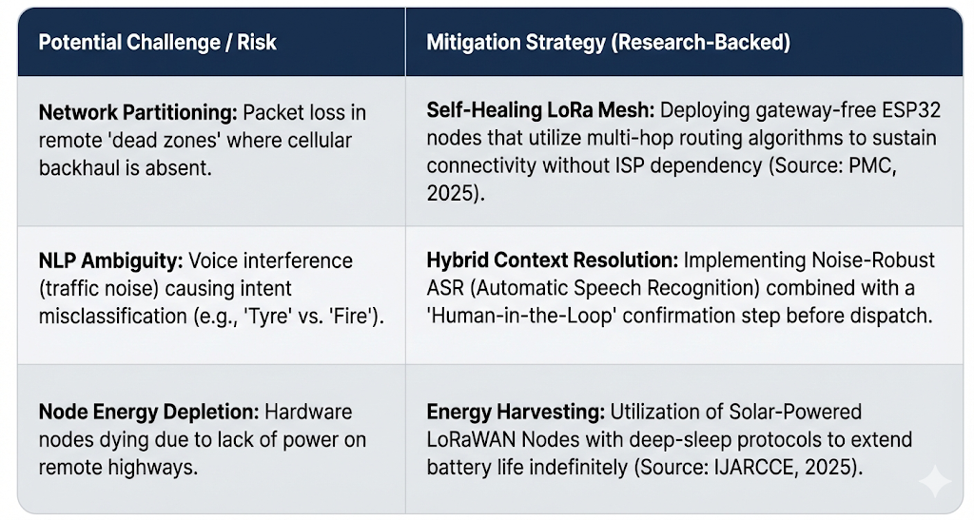

Feasibility & Viability
1. Feasibility Analysis
Technical Viability: The solution leverages mature Transformer architectures (LLMs) for high-accuracy intent detection and commercially available ESP32/WiFi modules for low-cost ($5/node) mesh implementation.
Operational Viability: The decentralized V2I (Vehicle-to-Infrastructure) model reduces dependency on centralized cellular towers, ensuring operational continuity in critical Indian highway sectors.
Page 4

Slide 5

Impacts & Benefits
1. Potential Impact on Target Audience
Reduced Panic & Stress: Drivers can request help naturally ("Help! My car stopped") without struggling with confusing app menus during an emergency.
Safety in Dead Zones: Ensures help reaches users even on remote highways where standard apps fail due to no signal.
Faster Response Time: AI instantly routes the request to the correct provider (Garage vs. Ambulance), saving critical minutes.
2. Benefits of the Solution
Social (Safety): Drastically reduces accident response times on highways, potentially saving lives.
Provides a safety net for vulnerable travelers in remote areas.
Economic (Efficiency): Increases revenue for local mechanics by connecting them directly to nearby stranded drivers.
Reduces logistics downtime for trucks and commercial vehicles by speeding up repairs.
Environmental (Sustainability): Smart Routing minimizes unnecessary travel for tow trucks, reducing fuel consumption.
Solar-Powered Nodes ensure the infrastructure is green and energy-efficient.
Page 5

Slide 6

Research & References
https://www.researchgate.net/publication/395776246_On_Road_Vehicle_Breakdown_Assistance
https://ieeexplore.ieee.org/document/8962283
https://www.researchgate.net/publication/379722899_All_about_Delay Tolerant_Networking_DTN_Contributions_to_Future_Internethttps://ieeexplore.ieee.org/document/8376311
https://ieeexplore.ieee.org/document/8376311
Page 6

